Slide 1
Programming Assignment – 3
Chapter 4, Question - 4
Monica Bernard
COT 5405

Slide 2
Pseudocode for both Brute Force and Optimized algorithms with time and space complexity
Brute Force Solution:
For n from 1 to 10: O(n) Nested for loops result with a
Generate S, S_opt and S_prime time complexity of O(n²)
for length of S_opt: O(n) Space Complexity is O(n) since
Search S_prime in S_opt starting from the 0th index variable n is increased linearly
Break out of the loop when a subset is found with time.
Increment index by 1.
Optimized Solution:
For n from 1 to 1000: O(n)
Generate S, S_opt, S_prime
SearchList= Consider first element of S_prime and store all indexes in S_opt that has this element
for length of SearchList: O(n)
Check if the elements after the index of interest are same as the elements in S_prime
Break out of the loop when a subset is found
increment to the next index

Slide 3
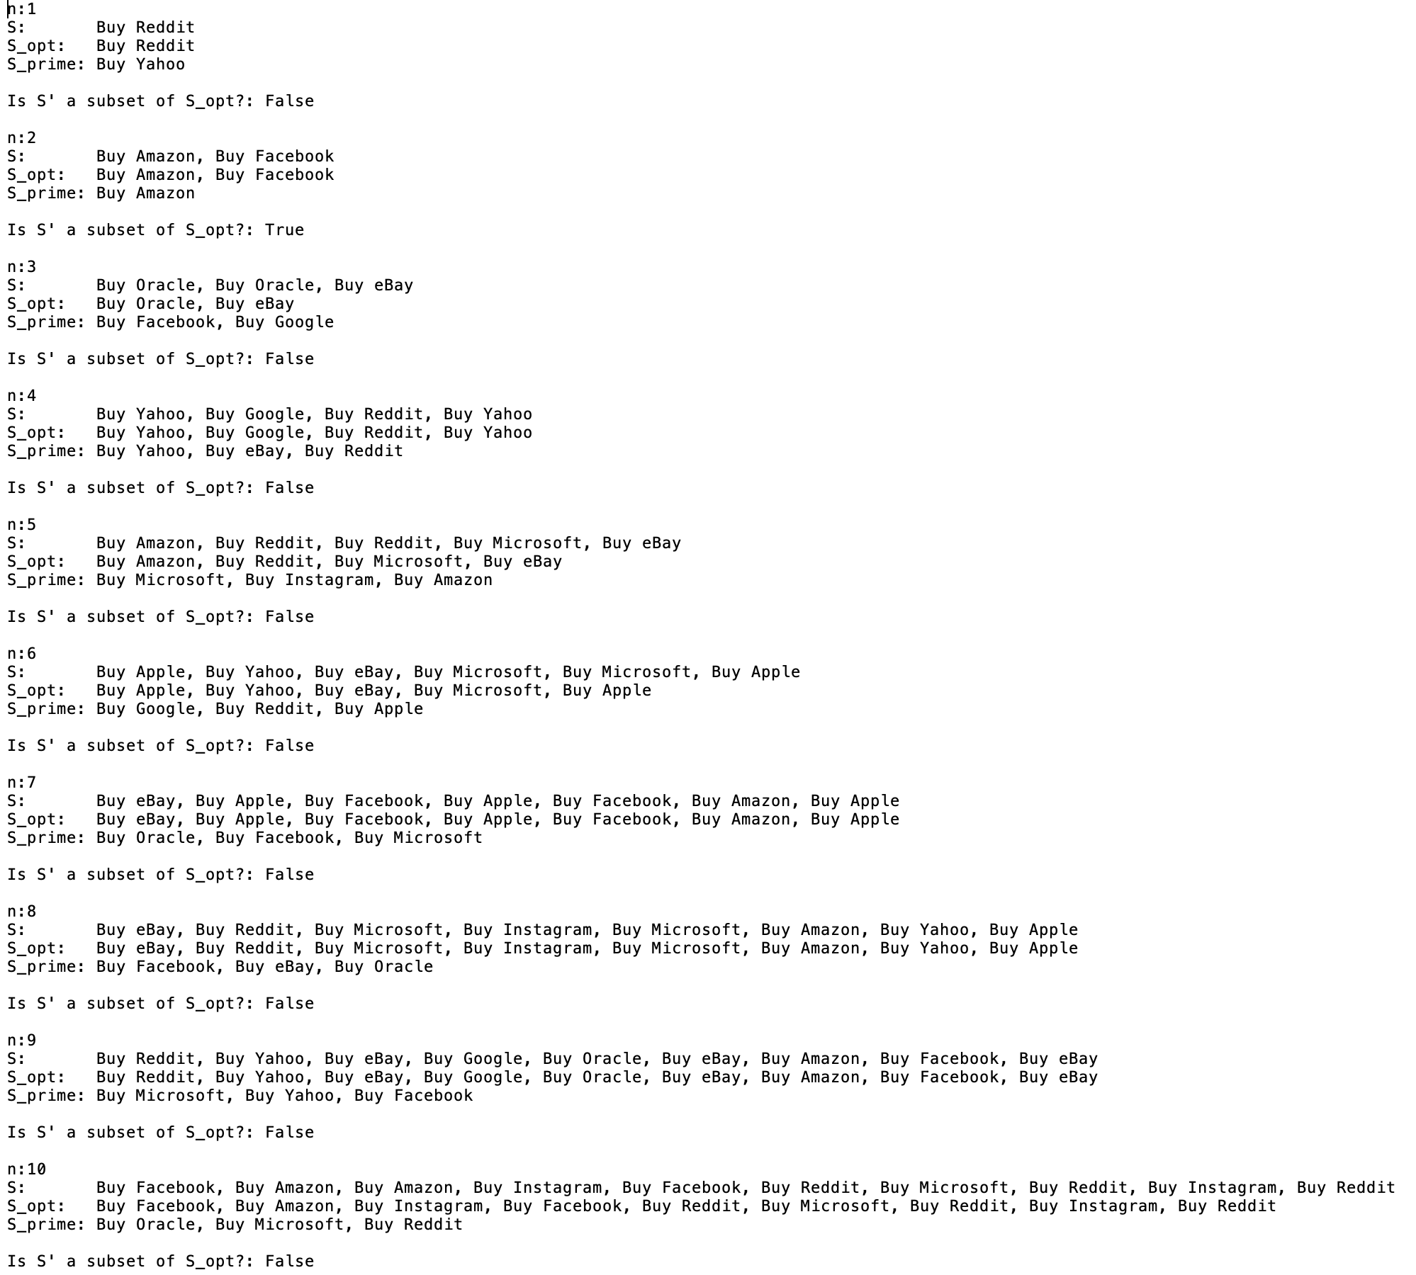
Brute Force Results for n = 1,2,3….10

Slide 4
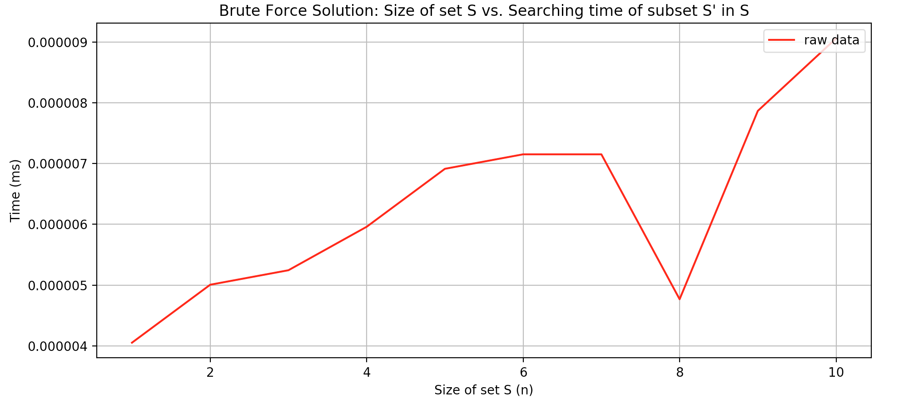
Brute Force: Time taken to search through S_opt to find a subset S_prime for n = 1,2,…10

Slide 5
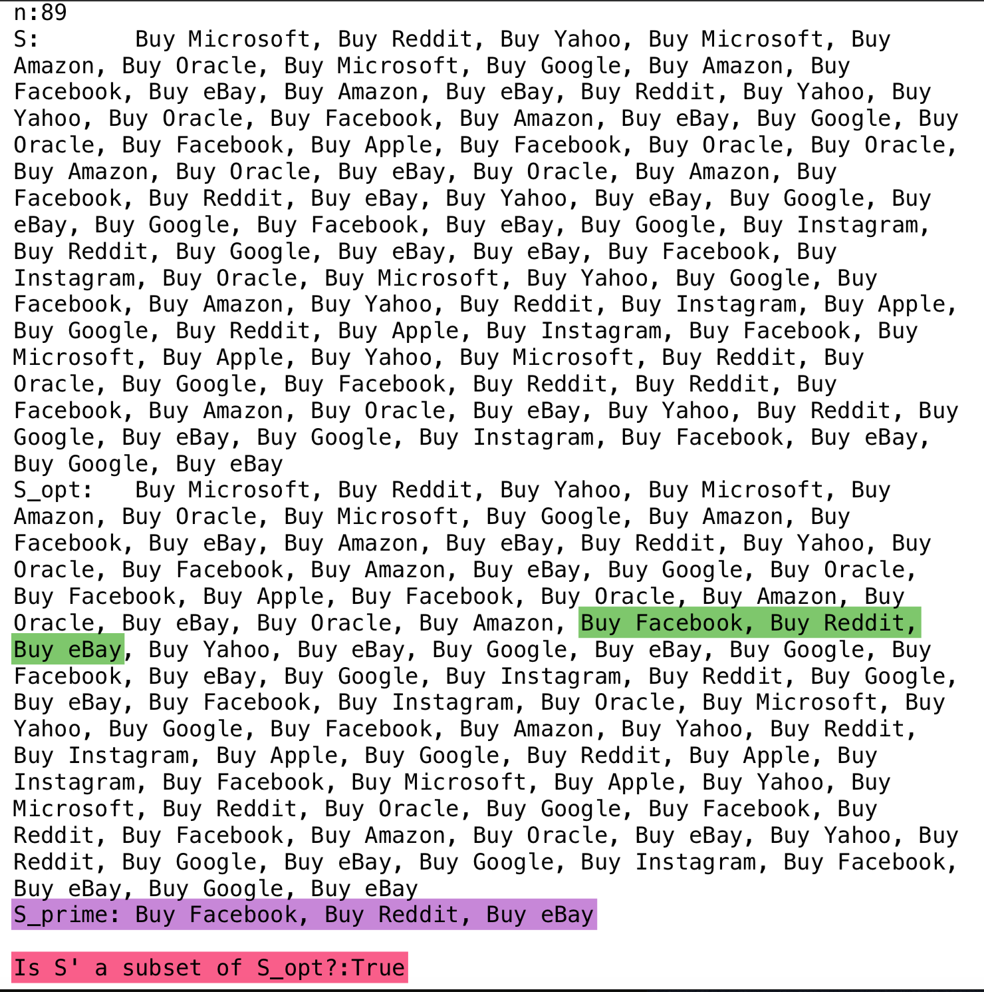
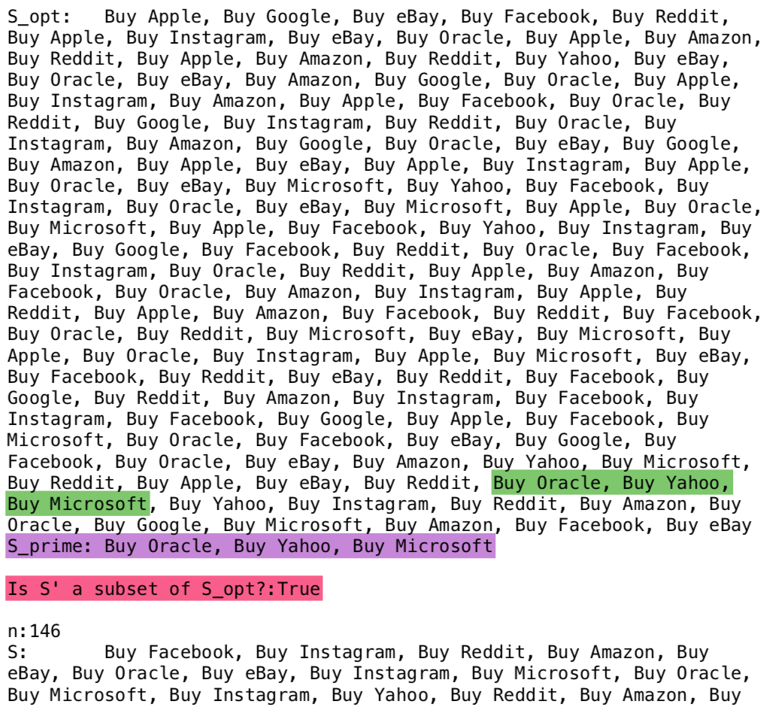
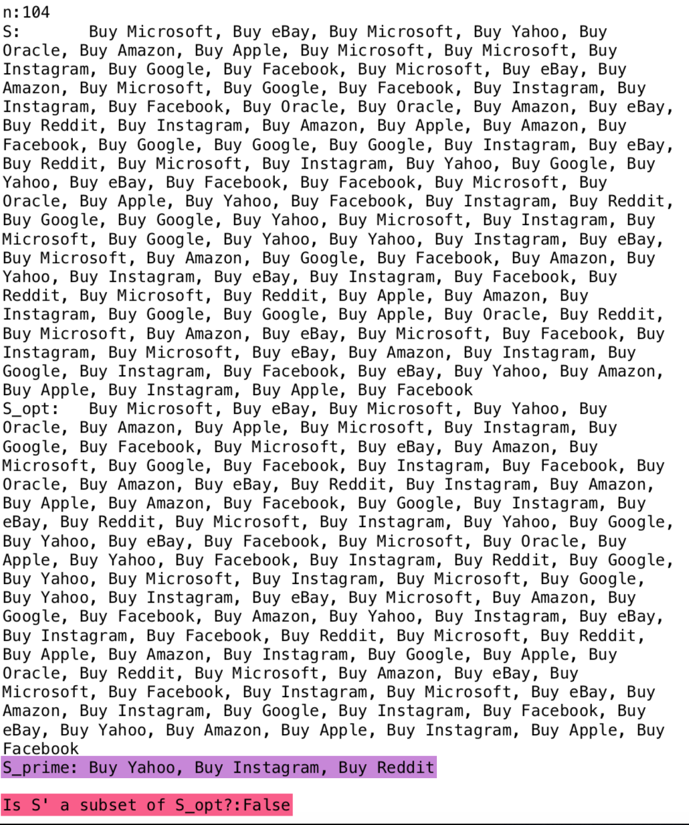
Some screenshots of a test run to validate optimized solution (n = 89, 104 and 145)

Slide 6
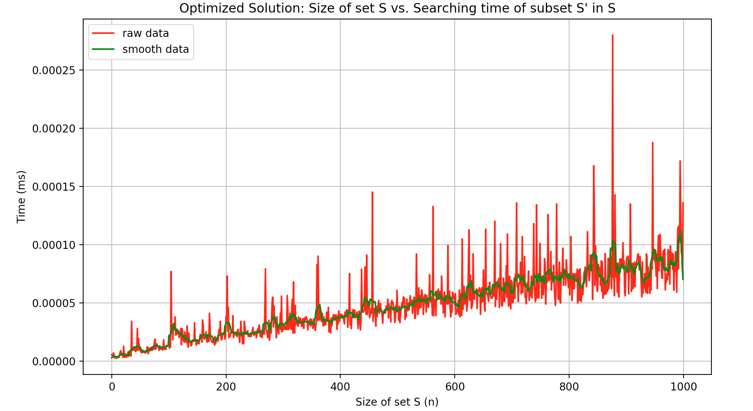
Optimized Solution: Time taken to search through S_opt to find a subset S_prime for n = 1,2,…1000

